Slide 1

Finpro Bank
Data Architecture, Implementation and Recommendations

Slide 2
Outline
Introduction
Data acquisition and cleaning
Database design and setup
Evaluation and interpretation
Data integration and security
Data reporting
General handover documentation
Insights and recommendations
Summary
Appendix

Slide 3
Introduction

Slide 4
Purpose of the presentation
Present a complete, structured handover of the FinPro Bank data management system I designed and implemented.
Document the full lifecycle of activities—from data acquisition and cleaning to reporting and dashboard development.
Ensure the incoming Data Manager can seamlessly maintain, troubleshoot, and enhance the existing data architecture.
Provide clear, human‑centered explanations, supported by screenshots, to make the transition smooth and efficient.

Slide 5
Summary of work done on the project
Performed end‑to‑end data acquisition, cleaning, validation, and transformation across multiple banking datasets.
Designed and implemented a relational database schema, including tables, constraints, indexing, and optimized storage.
Built structured ETL workflows to integrate customer, branch, transaction, and geographic data into a unified system.
Applied security and access controls, including user roles, privilege segmentation, and encryption of sensitive fields.
Developed interactive Tableau worksheets, dashboards, and storylines for branch‑level, country‑level, and overall performance analysis.
Prepared comprehensive handover documentation, ensuring clarity, maintainability, and continuity for the next Data Manager.

Slide 6
Data acquisition and cleaning

Slide 7
Data cleaning documentation (1 of 3)
Data Sources Used
Customer_Data.csv Contains customer demographics, age, gender, branch association, and account details.
Transaction_Data.csv Includes all financial transactions with timestamps, amounts, transaction types, and customer IDs.
Branch_Data.csv Provides branch codes, branch names, and geographic attributes.
US_Cities.csv / Country Mapping File Used for geolocation, country‑level mapping, and visualization enrichment.
Purpose of These Sources
Together, these datasets form the foundation for customer analytics, branch performance evaluation, and country‑wise transaction insights.

Slide 8
Data cleaning documentation (2 of 3)
Data Cleaning Steps Implemented and Data Cleaning Workflow
Handled Missing Values
Filled missing branch codes using customer‑branch mapping.
Removed rows with critical missing identifiers (CustomerID, TransactionID).
Removed Duplicates
Identified duplicate customer records using CustomerID.
Removed repeated transaction entries based on TransactionID + Timestamp.

Slide 9
Data cleaning documentation (3 of 3)
Standardized Data Formats
Converted dates to ISO format.
Normalized text fields (branch names, country names).
Standardized currency values.
Outlier Treatment
Validated negative balances and corrected data entry errors.
Notes:
Flagged extreme transaction amounts using IQR method in outlier treatment.
This ensures analytical accuracy, consistency, and reliability across all downstream processes.

Slide 10
Analysis and visualization using MS Excel (1 of 2)
Excel Formulas Used
Duplicate Detection: =COUNTIF(A:A, A2)
Missing Value Checks: =IF(ISBLANK(A2), "Missing", "OK")
Age Calculation from Date of Birth: =DATEDIF([@DateOfBirth], TODAY(), "Y")
For new column TransactionMonth: =TEXT([@TransactionDate], "MMMM")
VBA macro to
Remove duplicates
Standardize date formats
Apply conditional formatting for anomalies

Slide 11
Analysis and visualization using MS Excel (2 of 2)
Data Cleaning Principles Applied
Accuracy
Consistency
Completeness
Integrity
Auditability
Notes:
This aligns with best practices in Data Engineering and Data Governance.

Slide 12
Database design and setup

Slide 13
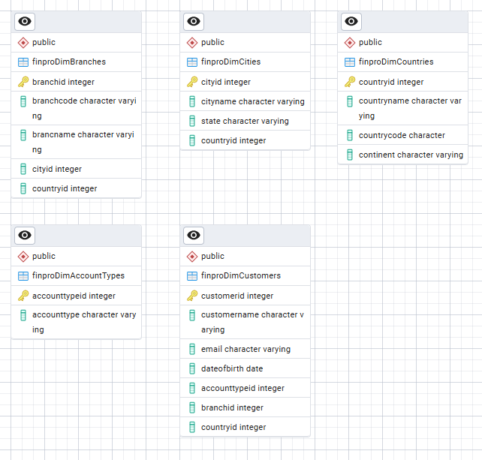
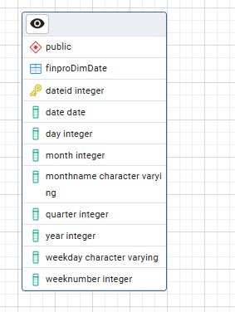
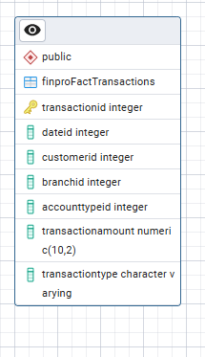
Entity relationship diagram (ERD) (1 of 3)
Dimension Tables
Dimension Date Table
Central Fact Table
Notes:
The FinPro Bank data model follows a structured analytical design consisting of:
Dimension tables for descriptive attributes
A central fact table for transactional data
A date dimension for time‑based reporting

Slide 14
Entity relationship diagram (ERD) (2 of 3)
Dimension Tables
finproDimCustomers Stores customer demographics, DOB, account type, and branch association.
finproDimBranches Contains branch codes, names, and geographic identifiers.
finproDimCities Provides city‑level attributes including state and country mapping.
finproDimCountries Stores country names, codes, and continent information.
finproDimAccountTypes Defines account categories such as Savings, Checking, etc.
finproDimDate A full date dimension enabling year, quarter, month, week, and day‑level analysis.
Fact Table
finproFactTransactions Captures all financial transactions with links to customer, branch, account type, and date.

Slide 15
Entity relationship diagram (ERD) (3 of 3)
Key Relationships
Customers → Branches (Many‑to‑One) Each customer belongs to a single branch.
Branches → Cities → Countries (Hierarchical) Enables geographic roll‑ups for reporting.
Transactions → Customers / Branches / Account Types / Date The fact table references all dimensions to support multi‑angle analysis.
Business Logic Behind the Design
Ensures single source of truth for customer, branch, and geographic attributes.
Supports time‑series analysis through the date dimension.
Enables drill‑down reporting (Country → City → Branch → Customer → Transaction).
Follows best practices in data warehousing for performance, scalability, and clarity.

Slide 16
Table structure design
Table | Key Columns | Data Types | Constraints
finproDimCustomers | customerid (PK), customername, email, dateofbirth, accounttypeid, branchid, countryid | int, varchar, date | PK(customerid), FK(accounttypeid), FK(branchid), FK(countryid)
finproDimBranches | branchid (PK), branchcode, branchname, cityid, countryid | int, varchar | PK(branchid), FK(cityid), FK(countryid)
finproDimCities | cityid (PK), cityname, state, countryid | int, varchar | PK(cityid), FK(countryid)
finproDimCountries | countryid (PK), countryname, countrycode, continent | int, varchar | PK(countryid)
finproDimAccountTypes | accounttypeid (PK), accounttype | int, varchar | PK(accounttypeid)
finproDimDate | dateid (PK), date, day, month, monthname, quarter, year, weekday, weeknumber | int, date, varchar | PK(dateid)
finproFactTransactions | transactionid (PK), dateid, customerid, branchid, accounttypeid, transactionamount, transactiontype | int, numeric, varchar | PK(transactionid), multiple FKs

Slide 17
OLAP schema (1 of 3)
Schema Used: Snowflake Schema
The FinPro Bank data model follows a snowflake schema, where dimension tables are normalized into multiple related tables (e.g., Branch → City → Country).
Why Snowflake?
Reduces redundancy
Improves data integrity
Supports hierarchical reporting (Country → City → Branch)
Aligns with enterprise‑grade data warehousing standards
Notes:
This structure is ideal for banking analytics where geographic and customer hierarchies matter.

Slide 18
OLAP schema (2 of 3)
Fact Table
finproFactTransactions Stores all measurable events (transactions). Supports KPIs such as total deposits, withdrawals, balances, and transaction counts.
Dimension Tables
Customer Dimension → demographic analysis
Branch Dimension → branch performance
City & Country Dimensions → geographic insights
Account Type Dimension → product segmentation
Date Dimension → time‑series reporting
Role in reporting
Branch‑wise performance dashboards
Country‑wise transaction analysis
Customer segmentation
Notes:
In reporting these tables also enable:
Time‑based trend analysis
Multi‑dimensional slicing and dicing

Slide 19
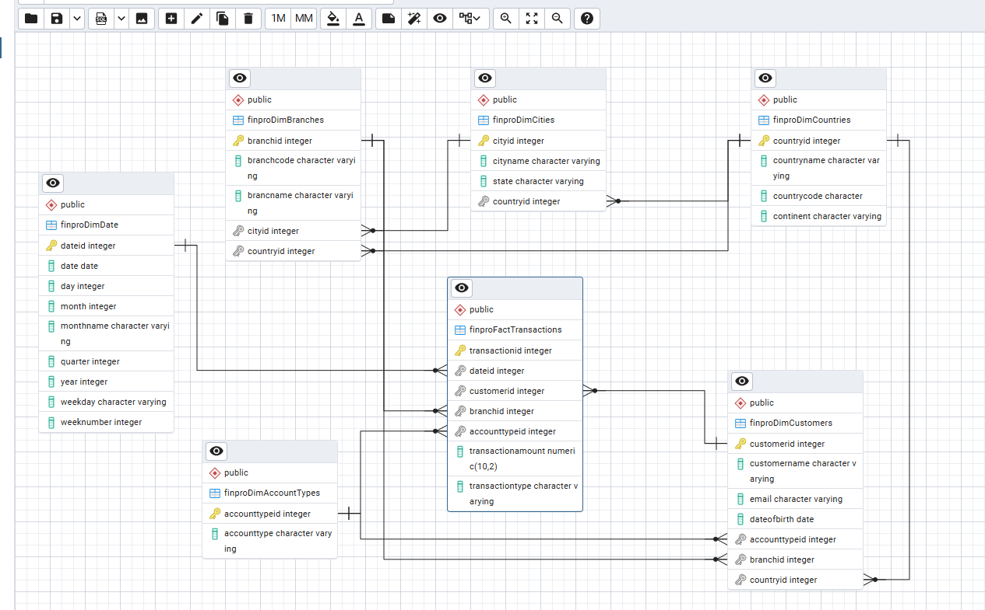
OLAP schema (3 of 3)
The fact table sits at the center, connected to all dimensions.
Each dimension provides a different analytical lens.
The snowflake structure supports both granular and aggregated reporting.
This design ensures fast, accurate, and scalable BI operations.

Slide 20
Evaluation and interpretation

Slide 21
Documenting SQL queries and scripts (1 of 7)
OLTP Scripts (Operational Transactions)
These scripts support day‑to‑day banking operations.
Create Tables (OLTP Layer)
CREATE TABLE finproDimCustomers (...)
CREATE TABLE finproFactTransactions (...) (Purpose: Define operational entities and enforce constraints.)
Insert Data (OLTP Layer)
INSERT INTO finproDimCustomers (...) VALUES (...);
INSERT INTO finproFactTransactions (...) VALUES (...); (Purpose: Load customer, branch, and transaction data.)
OLAP Scripts (Analytical Queries)
These scripts support reporting, dashboards, and insights.
Aggregations, Joins, Grouping Sets, Rollup, Cube
Used for branch‑wise totals, country‑wise counts, and time‑series analysis.

Slide 22
Documenting SQL queries and scripts (2 of 7)
OLTP Queries (Insert, Update, Delete)
1. Insert Operation
INSERT INTO finproFactTransactions
(transactionid, dateid, customerid, branchid, accounttypeid, transactionamount, transactiontype)
VALUES (10045, 20240115, 501, 12, 2, 850.00, 'Deposit’);
Purpose: Adds a new transaction to the system.
2. Update Operation
UPDATE finproDimCustomers
SET email = 'updated_email@example.com'
WHERE customerid = 501;
Purpose: Corrects customer information.
3. Delete Operation
DELETE FROM finproFactTransactions
WHERE condition;
Purpose: Removes erroneous or duplicate transactions.

Slide 23
Documenting SQL queries and scripts (3 of 7)
OLAP Queries (Aggregations, Joins, Rollup, Cube)
Branch‑Wise Total Transaction Amount
SELECT b.branchname,
SUM(f.transactionamount) AS total_amount
FROM finproFactTransactions f
JOIN finproDimBranches b ON f.branchid = b.branchid
GROUP BY b.branchname;
Purpose: Supports branch performance dashboards.

Slide 24
Documenting SQL queries and scripts (4 of 7)
Multi‑Level Aggregation Using GROUPING SETS
SELECT
customerid,
accountid,
SUM(balance) AS total_balance
FROM finproDimCustomers
GROUP BY GROUPING SETS (
(customerid, accountid), -- detailed level
(customerid), -- subtotal by customer
(accountid), -- subtotal by account
() -- grand total
);
Purpose: Generates detailed, subtotal, and grand‑total summaries for customer and account balances, supporting multi‑dimensional financial analysis.
Notes:
OLAP Queries (Aggregations, Joins, Rollup, Cube)

Slide 25
Documenting SQL queries and scripts (5 of 7)
3. ROLLUP — Branch → Account Type → Total
SELECT
customers.branchcode,
customers.accounttype,
SUM(facts.transactionamount) AS total_transaction
FROM finproFactTransactions AS facts
JOIN finproDimCustomers AS customers
ON facts.accountid = customers.accountid
GROUP BY ROLLUP (customers.branchcode, customers.accounttype);
Purpose:
Generates hierarchical summaries:
Branch + Account Type totals
Branch‑level subtotals
Grand total
Supports multi‑level reporting in dashboards.
Notes:
OLAP Queries (Aggregations, Joins, Rollup, Cube)

Slide 26
Documenting SQL queries and scripts (6 of 7)
4. CUBE — Year of Joining × Country × Balance
SELECT
EXTRACT(YEAR FROM TO_DATE(customers.datejoined, 'MM/DD/YYYY')) AS year_of_joining,
customers.country,
customers.balance + COALESCE(SUM(facts.transactionamount), 0) AS closing_balance
FROM finproDimCustomers AS customers
LEFT JOIN finproFactTransactions AS facts
ON customers.accountid = facts.accountid
GROUP BY CUBE (
EXTRACT(YEAR FROM TO_DATE(customers.datejoined, 'MM/DD/YYYY')),
customers.country,
customers.balance
);
Purpose:
Creates all possible combinations of:
Year
Country
Balance
Used for deep OLAP slicing/dicing and Tableau drill‑downs.
Notes:
OLAP Queries (Aggregations, Joins, Rollup, Cube)

Slide 27
Documenting SQL queries and scripts (7 of 7)
5. MQT — Materialized View for Branch‑Wise Totals
CREATE MATERIALIZED VIEW Total_transaction_per_branch AS
SELECT
customers.branchcode,
SUM(facts.transactionamount) AS total_transaction
FROM finproFactTransactions AS facts
JOIN finproDimCustomers AS customers
ON facts.accountid = customers.accountid
GROUP BY customers.branchcode;
Querying the MQT
SELECT * FROM Total_transaction_per_branch;
Purpose:
Improves performance by pre‑computing branch‑level totals.
Used for fast dashboard refresh and repeated analytical queries.

Slide 28
Inferences (1 of 4)
Inferences from OLTP Analysis
Customer Behavior Insights
Negative balances highlight overdraft risk and potential financial stress.
High positive balances identify premium‑eligible, high‑value customers.
Irregular transaction patterns suggest possible data entry issues or unusual activity.
Transaction Frequency Patterns
Frequent small withdrawals indicate cash‑flow sensitivity.
Large, infrequent deposits reflect salary or business‑driven behavior.
High withdrawals with low deposits may signal financial distress or fraud risk.

Slide 29
Inferences (2 of 4)
Inferences from OLTP Analysis
Data Quality Observations
Inconsistent emails and duplicate transactions show the need for stronger OLTP validation.
Actionable Takeaways
Flag negative‑balance accounts for follow‑up.
Target high‑balance customers with tailored products.
Strengthen validation rules to improve data accuracy.

Slide 30
Inferences (3 of 4)
Inferences from OLAP Analysis
ROLLUP Insights (Branch → Account Type)
Certain branches consistently outperform others.
Specific account types drive most activity within each branch.
Regional performance gaps highlight underperforming locations.
CUBE Insights (Year × Country × Balance)
Clear year‑over‑year growth in some countries; declines in others.
Geographic and joining‑year combinations reveal high‑value customer clusters.

Slide 31
Inferences (4 of 4)
Inferences from OLAP Analysis
MQT Insights (Branch‑Wise Totals)
High‑performing branches stand out clearly.
Pre‑computed totals improve dashboard performance and repeated analysis.
Provides a reliable baseline for monthly and quarterly reviews.
Actionable Takeaways
Invest in high‑performing regions; investigate low‑performing ones.
Use geographic trends for targeted marketing and retention strategies.
Leverage MQT outputs for faster, more consistent reporting.

Slide 32
Data integration and security

Slide 33
Data integration recommendations (1 of 3)
Areas Requiring Data Integration
Key Integration Points
Customer ↔ Branch ↔ Geography Ensures accurate mapping of customers to branches, cities, and countries.
Transactions ↔ Customers Required for closing balance, transaction frequency, and fraud analysis.
Date Dimension ↔ Fact Table Enables time‑series reporting (year, quarter, month, week).
Why Integration Matters
Reduces data silos
Ensures consistent reporting
Supports OLAP queries and Tableau dashboards
Improves data quality and governance

Slide 34
Data integration recommendations (2 of 3)
Recommended Integration Patterns
1. ETL (Extract‑Transform‑Load)
Ideal for scheduled batch loads
Cleans and standardizes data before loading
Fits FinPro’s CSV → SQL → Tableau workflow
2. ELT (Extract‑Load‑Transform)
Useful when raw data must be stored first
Leverages SQL transformations inside the warehouse
3. CDC (Change Data Capture)
Tracks inserts/updates/deletes
Ensures near‑real‑time updates for transactions
4. API‑Based Integration (Future‑Ready)
For connecting mobile banking, CRM, or fraud systems

Slide 35
Data integration recommendations (3 of 3)
Alignment with FinPro Bank’s Ecosystem
Why These Patterns Fit FinPro
Current system uses CSV ingestion + SQL warehouse → ETL is ideal
Transaction data changes frequently → CDC recommended
Tableau dashboards require clean, structured dimensions → ELT/ETL hybrid works
Future expansion (mobile app, CRM) → API integration readiness
Outcome
Reliable data flow
Faster reporting
Scalable architecture for future banking needs

Slide 36
Security documentation (1 of 3)
Role‑Based Access Control (RBAC)
Why RBAC Matters
Protects sensitive data
Prevents unauthorized changes
Ensures auditability
Allowed | Restricted
SELECT on all dimension tables SELECT + INSERT on fact table (for new transactions) UPDATE on customer email/phone fields | No DELETE on fact tables No access to encrypted columns (DOB, email hash) No privilege to alter schemas or create tables
Notes:
Controls what the fin_manager can view, insert, update, or delete.

Slide 37
Security documentation (2 of 3)
Column‑Level Encryption Guidelines
Sensitive Columns
Customer email
Date of birth
Account number
Outcome
Protects PII
Ensures compliance with banking security standards
Encryption Approach | fin_manager Access
Use AES_ENCRYPT / AES_DECRYPT Store encrypted values in separate columns Keep encryption keys in a secure vault (not in SQL scripts) | Can view decrypted values only when necessary Cannot access encryption keys Cannot modify encrypted columns directly

Slide 38
Security documentation (3 of 3)
Step‑by‑Step Procedure
Create Role CREATE ROLE fin_manager;
Grant Read Access GRANT SELECT ON ALL TABLES IN SCHEMA public TO fin_manager;
Grant Limited Write Access GRANT INSERT, UPDATE ON finproFactTransactions TO fin_manager;
Restrict Sensitive Tables REVOKE SELECT ON encrypted_columns FROM fin_manager;
Test Permissions Ensure fin_manager cannot delete or alter tables.
Examples
Granted: SELECT on customers, branches, countries
Restricted: DELETE on fact tables, ALTER TABLE, access to encrypted fields
Outcome
Controlled access Reduced risk Clear audit trail

Slide 39
Data reporting

Slide 40
Report specifications (1 of 6)
Data Sources Imported into Tableau
Account_Type.csv Contains account type categories used for customer segmentation and filtering.
Branches.csv Includes branch codes, branch names, and geographic identifiers used for branch‑wise reporting.
Countries.csv Provides country names and codes used for country‑wise transaction analysis and map visualizations.
Customer_Data.xlsx Contains customer demographics, DOB (for age calculation), account type, and branch mapping.
Transaction_Data.xlsx Stores transaction amounts, transaction types, dates, and customer IDs — the core source for closing balance and transaction count reports.
US_Cities.csv Provides city‑level geographic information used for branch/city mapping where applicable.
Relevance to Tableau Reports
Customer‑wise closing balance
Branch‑wise closing balance
Country‑wise transaction count
Customer‑wise average age
Dashboard and story creation.

Slide 41
Report specifications (2 of 6)
Filters & Calculated Fields
Key Filters
Branch Filter → isolate performance by branch
Country Filter → geographic segmentation
Transaction Type Filter → deposits vs withdrawals
Date Filter → year, quarter, month
Key Calculated Fields (These fields power all customer‑wise, branch‑wise, and country‑wise dashboards.)
Closing Balance | [Balance] + IF [Transaction Type] = 'Deposit' THEN [Transaction Amount] ELSE -[Transaction Amount] END
Age | DATEDIFF('year', [Date of Birth], TODAY())
Rounded Average Age | ROUND(AVG([Age]))

Slide 42
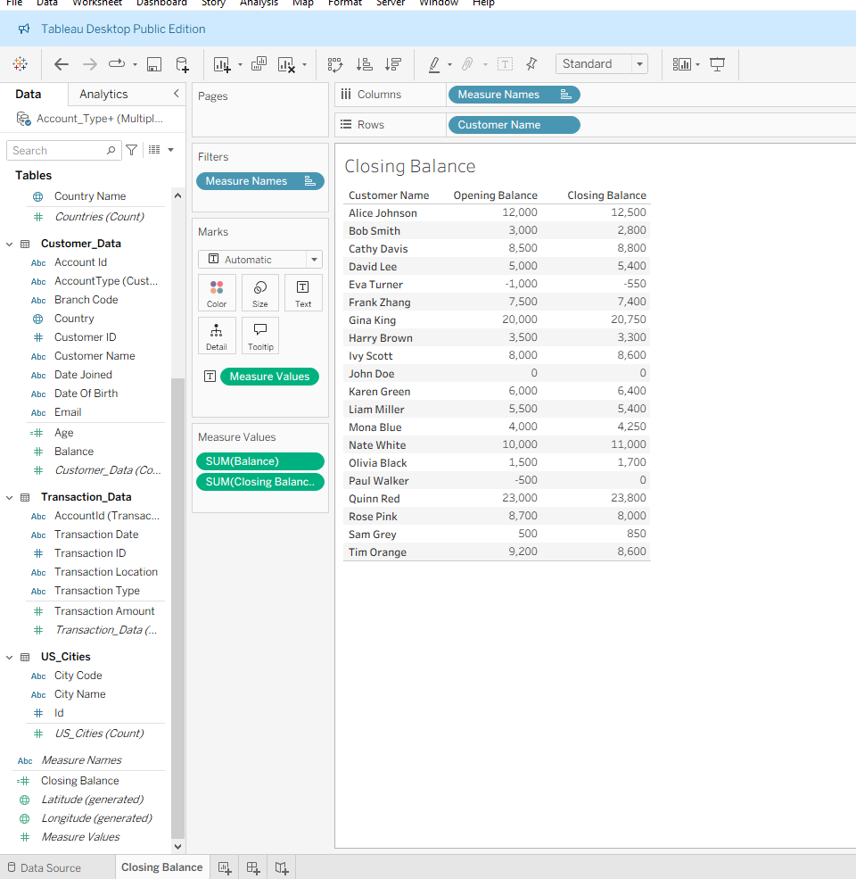
Report specifications (3 of 6)
Customer‑Wise Closing Balance Report (Tableau)
Purpose
Shows each customer’s final balance after all transactions — used for customer segmentation and risk assessment.
How It Was Built in Tableau
Connected fact + customer dimension
Created Closing Balance calculated field
Used SUM(Closing Balance) as measure
Placed Customer Name on Rows
Sorted descending by balance
Added Branch and Country filters
Formatted as a bar chart for clarity
Relevance
Identifies high‑value customers and accounts with negative balances.

Slide 43
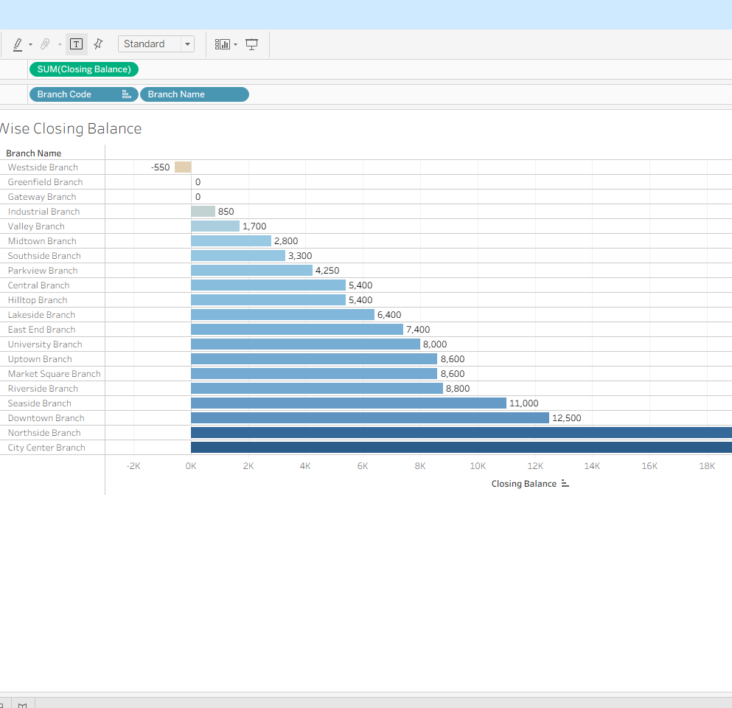
Report specifications (4 of 6)
Branch‑Wise Closing Balance Report (Tableau)
Purpose
Shows total closing balance per branch — used for branch performance evaluation.
How It Was Built
Aggregated SUM(Closing Balance) by Branch Code
Used Bar Chart for comparison
Added Branch Filter
Applied color encoding for high vs low balance
Used Label Marks for readability
Relevance
Supports regional performance reviews and resource allocation.

Slide 44
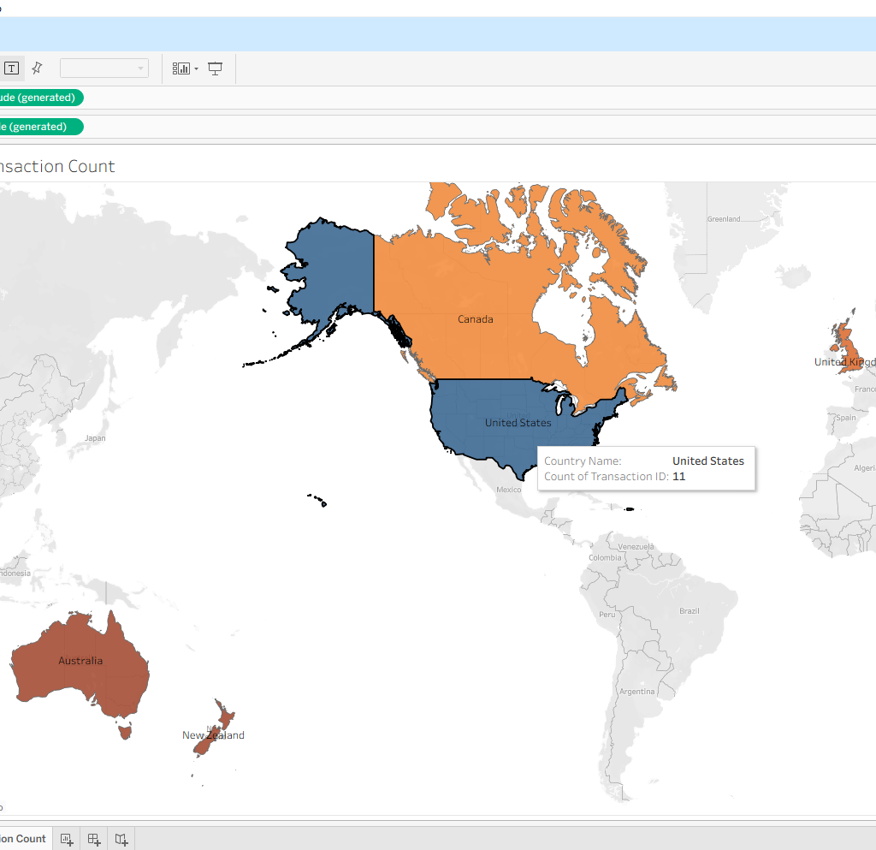
Report specifications (5 of 6)
Country‑Wise Transaction Count Report (Tableau)
Purpose
Shows total number of transactions per country — used for geographic insights.
How It Was Built
Joined fact table with country dimension
Used COUNT(TransactionID)
Built a filled map visualization
Applied Country Filter
Used color intensity to show transaction volume
Relevance
Highlights high‑activity regions and potential growth markets.

Slide 45
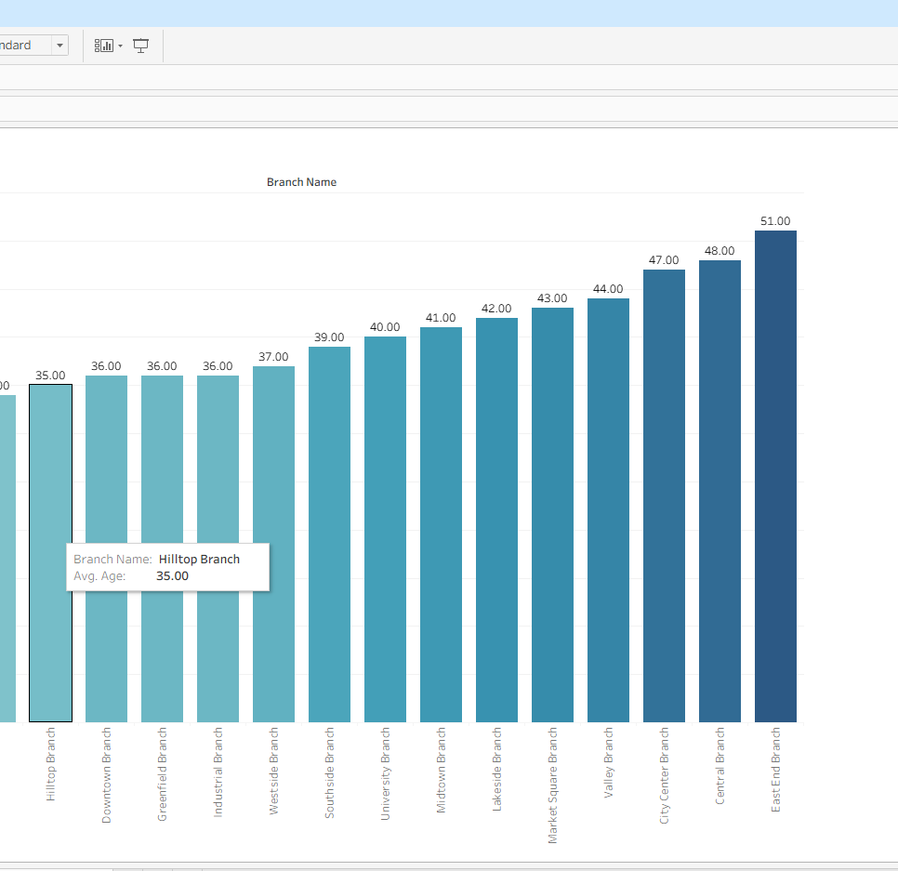
Report specifications (6 of 6)
Customer‑Wise Average Age Report (Tableau)
Purpose
Shows average customer age per branch or country — used for demographic segmentation.
How It Was Built
Created Age and Rounded Average Age fields
Grouped by Customer or Branch
Used Bar Chart
Added filter for Average Age
Relevance
Supports targeted marketing and customer profiling.

Slide 46
Performance analysis guidelines (1 of 3)
KPIs for Performance Analysis
Key KPIs Used
Total Transactions COUNT(TransactionID)
Closing Balance SUM(Closing Balance)
Average Transaction Amount SUM(Transaction Amount) / COUNT(TransactionID)
Deposit vs Withdrawal Ratio Deposits ÷ Withdrawals
Branch Performance Score Weighted score using balance + transaction count
Customer Average Age AVG(Age)
Role in Decision‑Making
Identifies high‑value customers Highlights strong and weak branches Supports marketing and retention strategies Helps detect anomalies or risk patterns

Slide 47
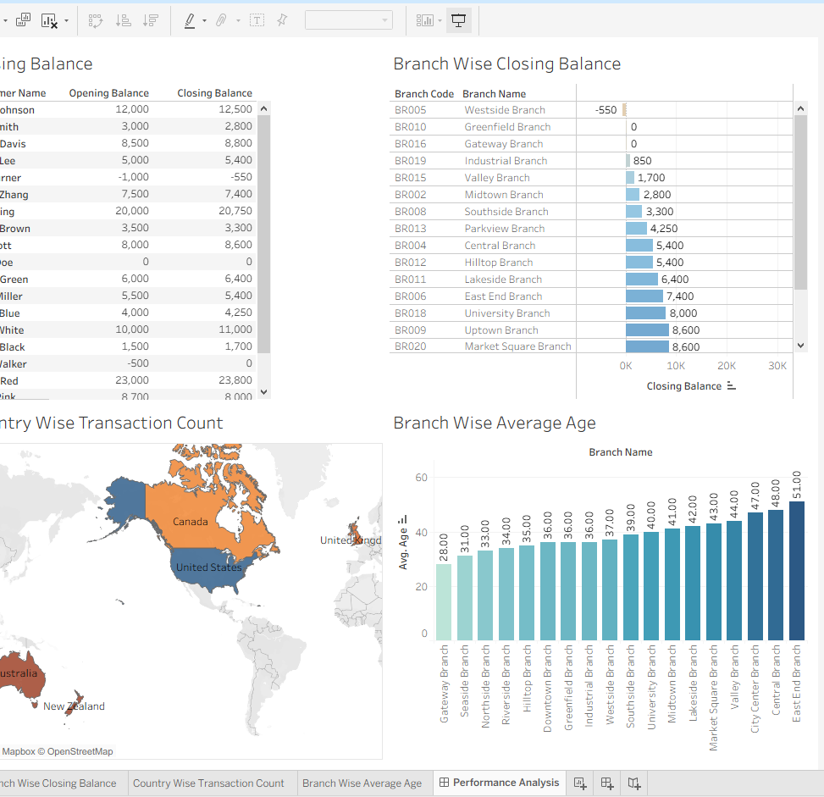
Performance analysis guidelines (2 of 3)
Dashboard, Story & Maintenance Steps
Dashboard Purpose
Combines customer, branch, and country insights
Enables interactive filtering and drill‑down
Provides a single view for decision‑makers
Story Purpose
Presents insights in a narrative sequence
Highlights key findings from OLTP + OLAP analysis

Slide 48
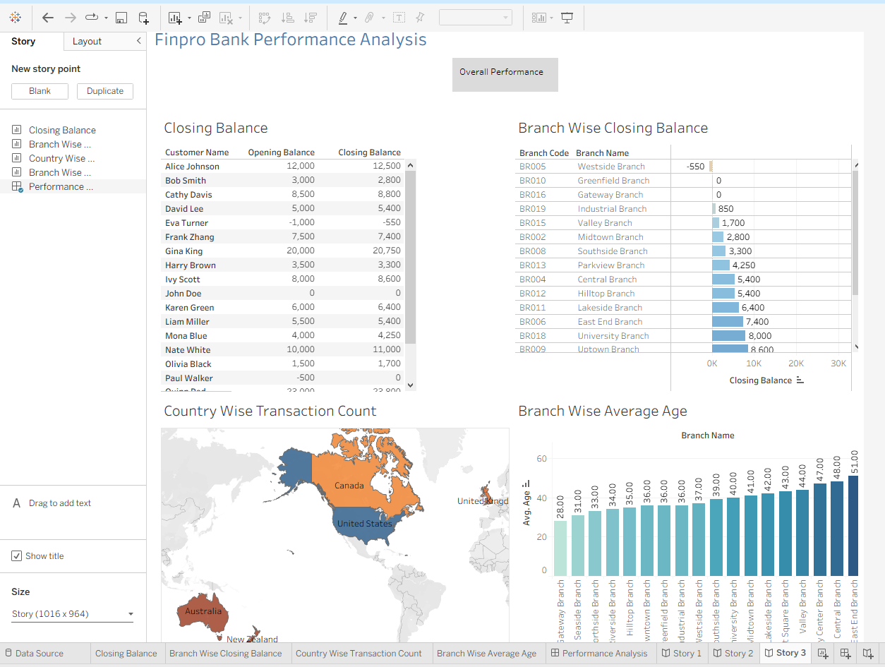
Performance analysis guidelines (3 of 3)
Maintenance Steps
Refresh data sources (CSV → SQL → Tableau)
Re‑run ETL/ELT scripts
Update calculated fields if schema changes
Add/remove KPIs based on business needs
Optimize performance by:
Using extracts
Removing unused fields
Aggregating data where possible

Slide 49
General handover documentation

Slide 50
Role and key responsibilities
Role Summary
As the Data Engineer / Data Manager for the FinPro Bank Capstone Project, I was responsible for designing, integrating, securing, and operationalizing the full data lifecycle — from ingestion to reporting.
Key Responsibilities
Data Ingestion & Integration
OLTP & OLAP Data Modeling
SQL Development
Tableau BI Development
Data Quality & Governance
Security & Access Control
Contribution to Project Goals
Delivered a secure, integrated, analytics‑ready data environment enabling accurate reporting, faster insights, and reliable decision‑making for FinPro Bank.

Slide 51
System architecture diagram - i
High‑Level Architecture (Data Engineer View)
Source Files (CSV / Excel)
-----------------------------------------------------------
↓ Data Cleaning & Validation
OLTP Layer (SQL Database)
-----------------------------------------------------------
Cleaned tables, PK/FK enforcement,
inserts/updates/deletes, operational queries
-----------------------------------------------------------
↓ Transformation & Aggregation

Slide 52
System architecture diagram - ii
High‑Level Architecture (Data Engineer View)
--------------------------------------------------------
↓ Transformation & Aggregation
OLAP Layer (Analytical SQL)
-------------------------------------------------------
ROLLUP, CUBE, GROUPING SETS,
Materialized Views, analytical joins
-------------------------------------------------------
↓ BI Consumption

Slide 53
System architecture diagram- iii
High‑Level Architecture (Data Engineer View)
---------------------------------------------------------
↓ BI Consumption
Tableau Reporting Layer
---------------------------------------------------------
Dashboards:
- Customer Closing Balance
- Branch Closing Balance
- Country Transaction Count
- Customer Average Age
Storyboards, KPIs, filters, calculated fields
--------------------------------------------------------

Slide 54
Key challenges and resolutions - i
1. Schema Mismatches Between Files & SQL
Issue: Column names and data types differed between CSV/XLSX files and SQL schema.
Resolution: Standardized naming, fixed data types, aligned join keys (CustomerID, BranchCode, CountryID).
2. Data Quality Issues
Issue: Inconsistent email formats, missing DOB values, duplicate transactions, invalid dates.
Resolution: Cleaned data in Excel, applied validation rules, removed duplicates, corrected formats.
3. Tableau Join Problems
Issue: Wrong join types caused inflated or missing values.
Resolution: Rebuilt relationships using correct keys; validated row counts and aggregates.

Slide 55
Key challenges and resolutions - ii
4. Closing Balance Calculation Errors
Issue: Deposits/withdrawals not aggregating correctly.
Resolution: Created a robust conditional calculated field and validated against sample transactions.
5. Performance Bottlenecks
Issue: Tableau dashboards slow due to large transaction data.
Resolution: Used extracts, removed unused fields, optimized filters, and aggregated data.
6. Security & RBAC Gaps
Issue: fin_manager role lacked clear permissions.
Resolution: Defined RBAC, restricted sensitive columns, assigned table‑specific privileges.

Slide 56
Insights and recommendations

Slide 57
Insights and recommendations - i
1. Data Quality Drives Everything
FinPro’s source files (Customer, Transactions, Branches, Countries, Account Types, US Cities) required extensive cleaning — inconsistent emails, mismatched IDs, missing DOBs, and duplicate transactions. These issues directly affected SQL joins, OLAP aggregations, and Tableau dashboards.
Recommendation: Establish a repeatable data‑quality routine: validate schemas, standardize formats, enforce PK/FK relationships, and run duplicate checks before loading data into SQL or Tableau.

Slide 58
Insights and recommendations - ii
2. Maintain a Clear OLTP → OLAP → Tableau Pipeline
The project relies on a structured flow: Source Files → SQL OLTP → SQL OLAP → Tableau Dashboards Your closing balance logic, ROLLUP/CUBE queries, and Tableau calculated fields all depend on consistent join keys and clean transformations.
Recommendation: Document the integration logic, especially how closing balance is calculated, how OLAP outputs feed Tableau, and how relationships are defined. This prevents breakage when new data arrives or schemas evolve.

Slide 59
Insights and recommendations - iii
3. Strengthen Security & Governance Early
The fin_manager role required careful RBAC design, column‑level encryption guidelines, and table‑specific privileges. These controls protect sensitive customer data and ensure compliance.
Recommendation: Maintain a security playbook: define roles, restrict sensitive columns, outline encryption steps, and validate permissions regularly. This ensures safe, auditable access as the system grows.

Slide 60
Summary
End‑to‑End Data Management for FinPro Bank
This capstone project demonstrated how a modern data pipeline transforms fragmented financial data into reliable, secure, and actionable insights. Through hands‑on work across Excel, SQL, OLTP, OLAP, security, governance, and Tableau, the project showcased the full lifecycle of data management in a banking environment.
What the Project Achieved
Cleaned and standardized raw data from multiple CSV/XLSX sources.
Built OLTP structures and validated operational data using SQL.
Designed an OLAP warehouse with rollups, cubes, and materialized views.
Integrated data across all layers, ensuring consistency from source files to analytics.
Implemented security and governance, including RBAC, encryption guidance, and controlled privileges.
Delivered Tableau dashboards and stories that provide clear insights into customers, branches, transactions, and demographics.
Overall Impact
The project delivered a complete, secure, and analytics‑ready data ecosystem — enabling FinPro Bank to make faster, data‑driven decisions and demonstrating the full skill set of a modern Data Manager.

Slide 61

Appendix

Slide 62
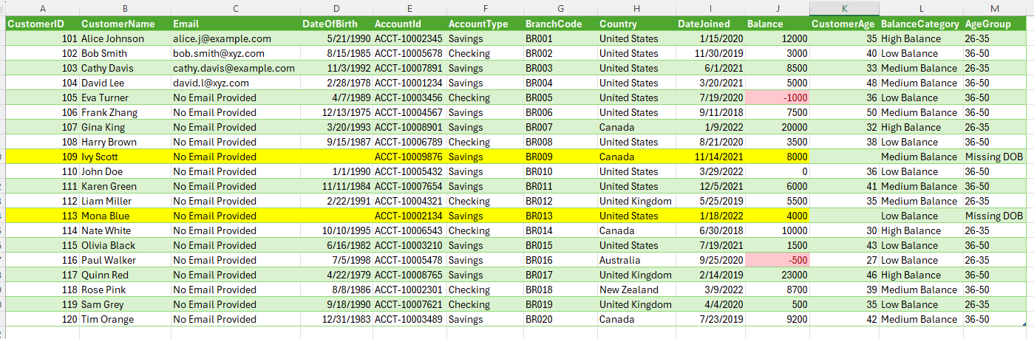
Appendix #
Excel Data Cleaning & Transformation Worksheets Includes customer demographics, DOB corrections, balance categorization, age group segmentation, and validation checks performed during preprocessing.

Slide 63
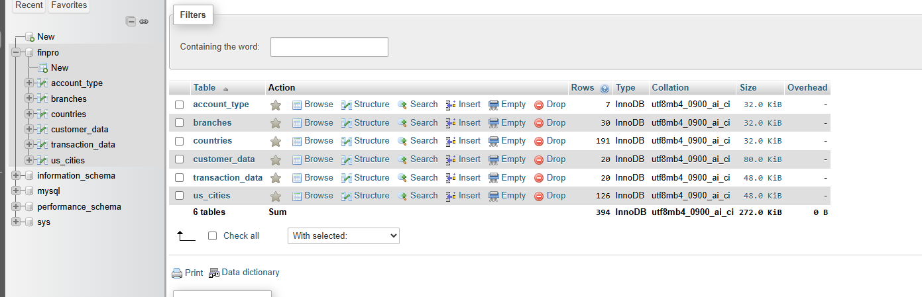
Appendix #
Database Structure (phpMyAdmin View) Shows the final SQL schema for the FinPro project, including: account_type, branches, countries, customer_data, transaction_data, us_cities Demonstrates successful data migration, table creation, and relational integrity.

Slide 64
Appendix #
Tableau Links
Customer & Branch Performance Dashboard
Country‑Wise Transaction Analysis
FinPro Storyboard

